Slide 1
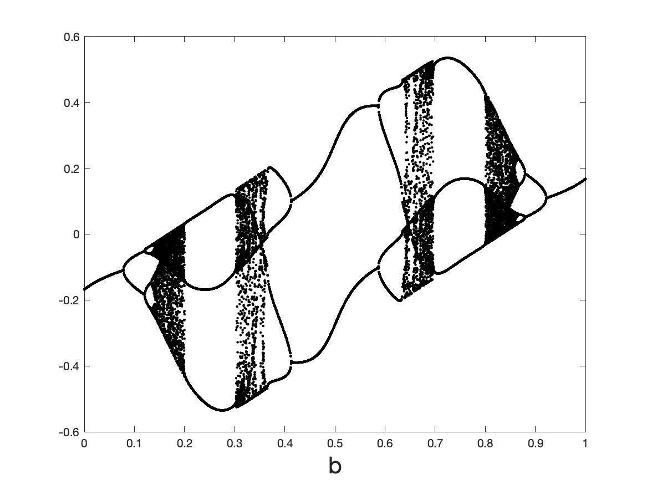


Lecture 7. Neural ODES for, and as, dynamical systems
Chris Budd OBE (Bath)

Slide 2
Some papers/books to look at
Chen et. al., Neural Ordinary Differential Equations
Matlab and Simulink, Dynamical System Modelling Using Neural ODE
di Bernardo et. al., Piecewise smooth dynamical systems
Brunton, Kutz et. al, Discovering governing equations from data by sparse identification of nonlinear dynamical systems
Ashwin et. al. RNNS

Slide 3
Dynamical systems
Flows:
Maps:
$x\left(0\right), { x}_{0}$ Given. Study the evolution from this state

Slide 4
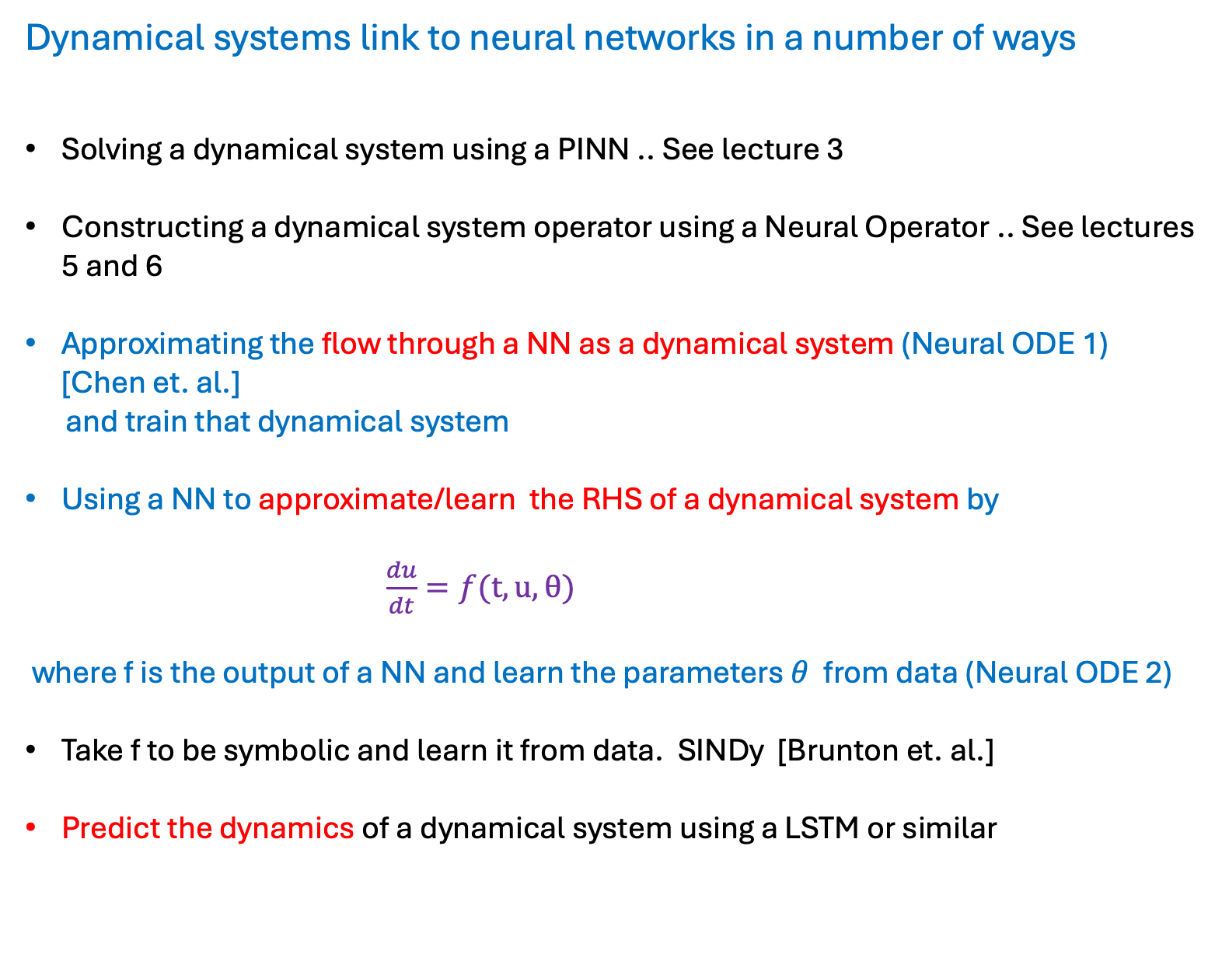
Dynamical systems link to neural networks in a number of ways
Solving a dynamical system using a PINN .. See lecture 3
Constructing a dynamical system operator using a Neural Operator .. See lectures 5 and 6
Approximating the flow through a NN as a dynamical system (Neural ODE 1) [Chen et. al.]
and train that dynamical system
Using a NN to approximate/learn the RHS of a dynamical system by
$\frac{du}{dt}=f(t,u,θ)$
where f is the output of a NN and learn the parameters $θ$ from data (Neural ODE 2)
Take f to be symbolic and learn it from data. SINDy [Brunton et. al.]
Predict the dynamics of a dynamical system using a LSTM or similar

Slide 5
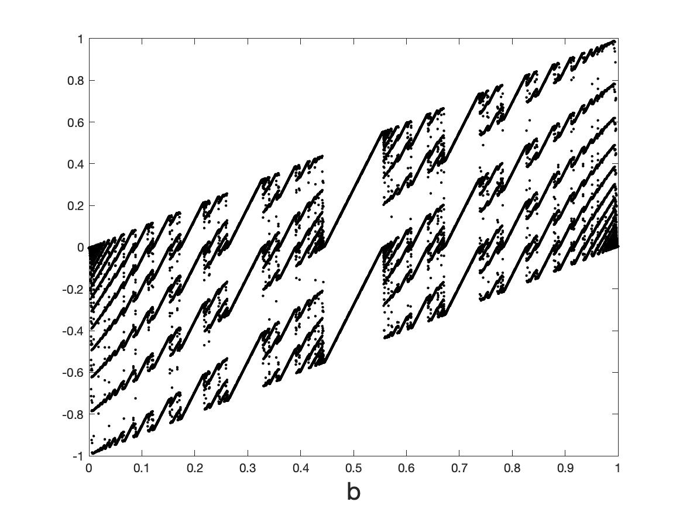
AIM:
Understand, and control, the dynamical behaviour and training of (feed forward) Neural Nets and Neural ODEs by using results from the theory of
dynamical systems (smooth and non-smooth)

Slide 6
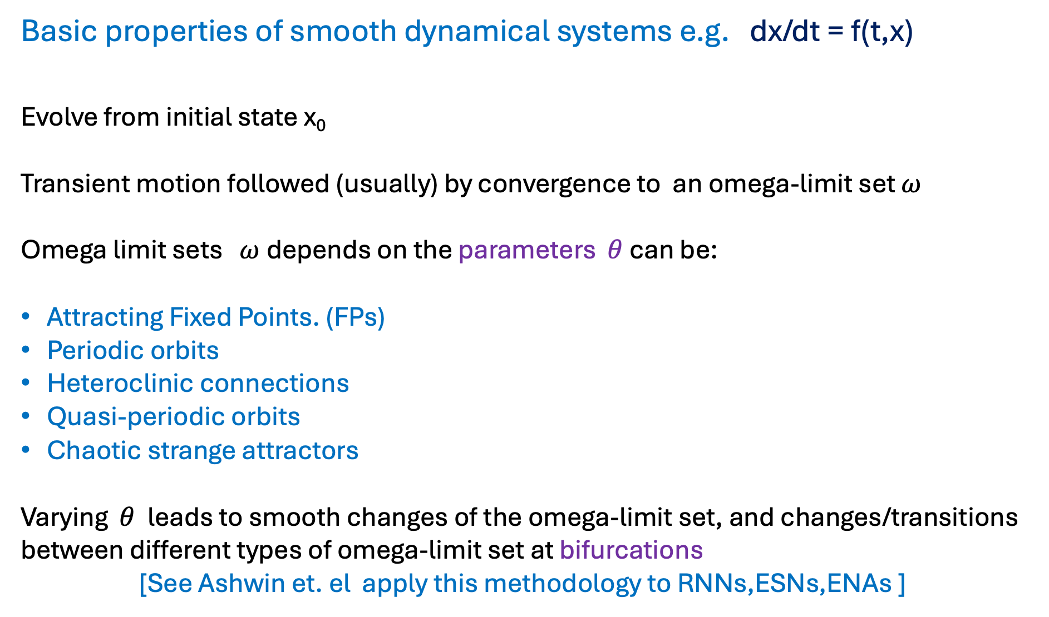
Basic properties of smooth dynamical systems e.g. dx/dt = f(t,x)
Evolve from initial state x₀
Transient motion followed (usually) by convergence to an omega-limit set $ω$
Omega limit sets $ω$depends on the parameters $θ$ can be:
Attracting Fixed Points. (FPs)
Periodic orbits
Heteroclinic connections
Quasi-periodic orbits
Chaotic strange attractors
Varying $θ$ leads to smooth changes of the omega-limit set, and changes/transitions between different types of omega-limit set at bifurcations
[See Ashwin et. el apply this methodology to RNNs,ESNs,ENAs ]

Slide 7
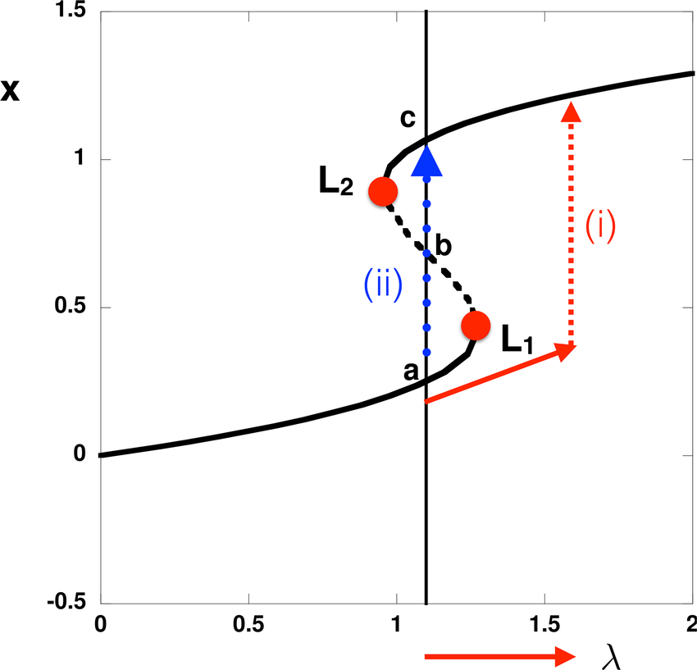
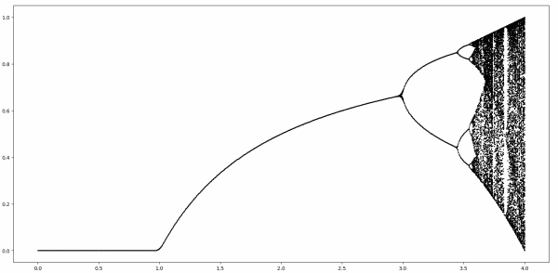
Examples of smooth bifurcations:
Saddle node and tipping points
Transcritical and Pitchfork (super and sub critical)
Period-doubling (and period doubling cascade to chaos)
Hopf (super and sub critical)
Cyclic fold
Homoclinic/heteroclinic

Slide 8
NNs as Dynamical Systems
All feed forward NNs and RNNs can be thought of as maps:
Eg.
Defines a parametrized map
NN: Input x₀ output x_{N} .
Deep if N >>1. Then we can study the output of the NN as the omega limit set of the map. Training then relates to how the omega limit set depends on the parameters eg. bifurcations etc.

Slide 9

Can be
Smooth
Or
Non-smooth
Depending on the activation function
Discontinuous
Smoothed discontinuous
Discontinuous derivative
Discontinuous derivative

Slide 10
Lack of smoothness can lead to very rich dynamics
Partly explains the great expressivity of a deep neural network

Slide 11
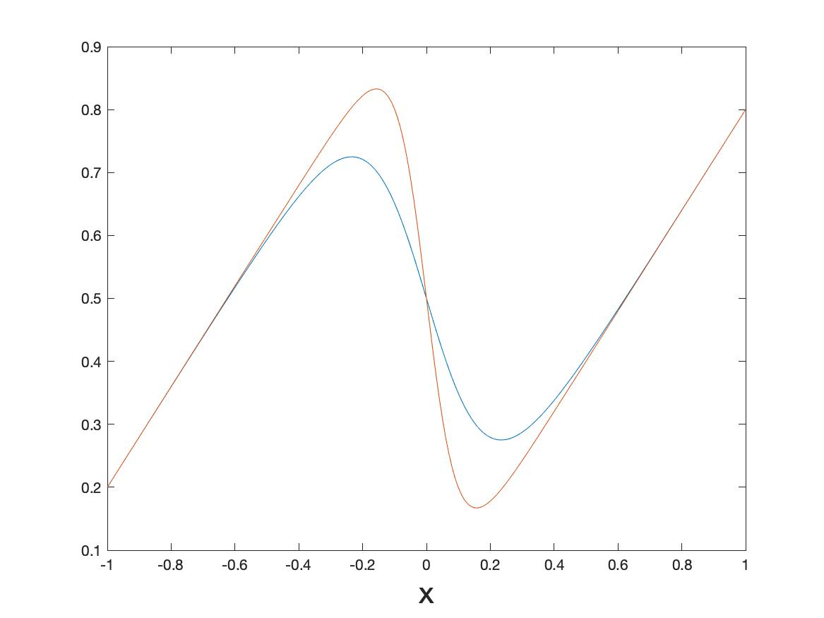
Case Study : Feed forward NN: One-d smoothed sigmoid map
Smoothed to:
c = 10
c = 5

Slide 12
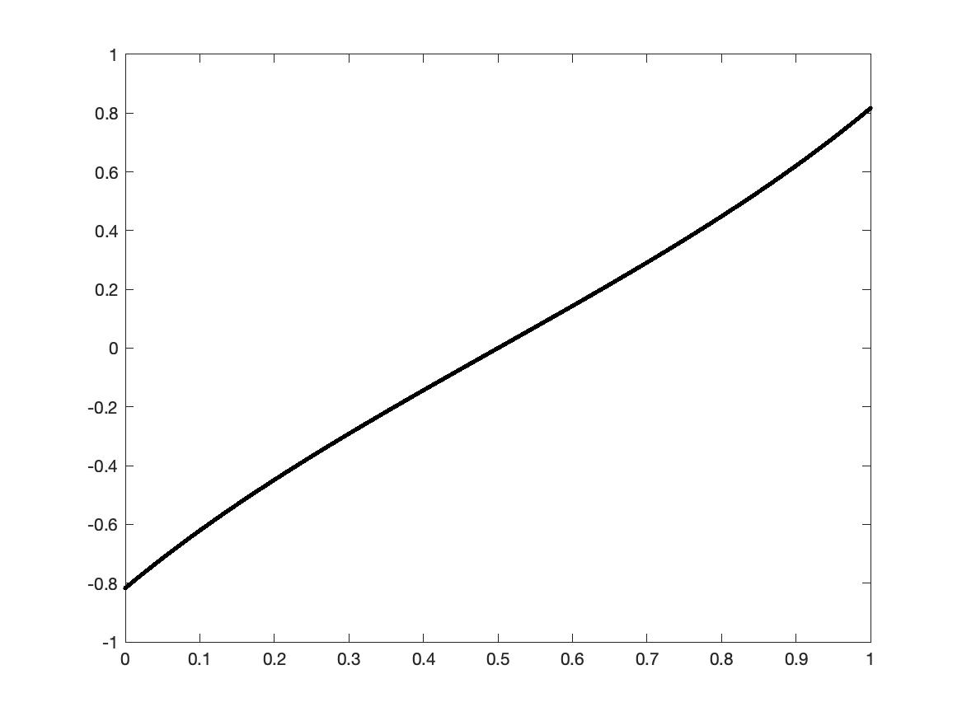
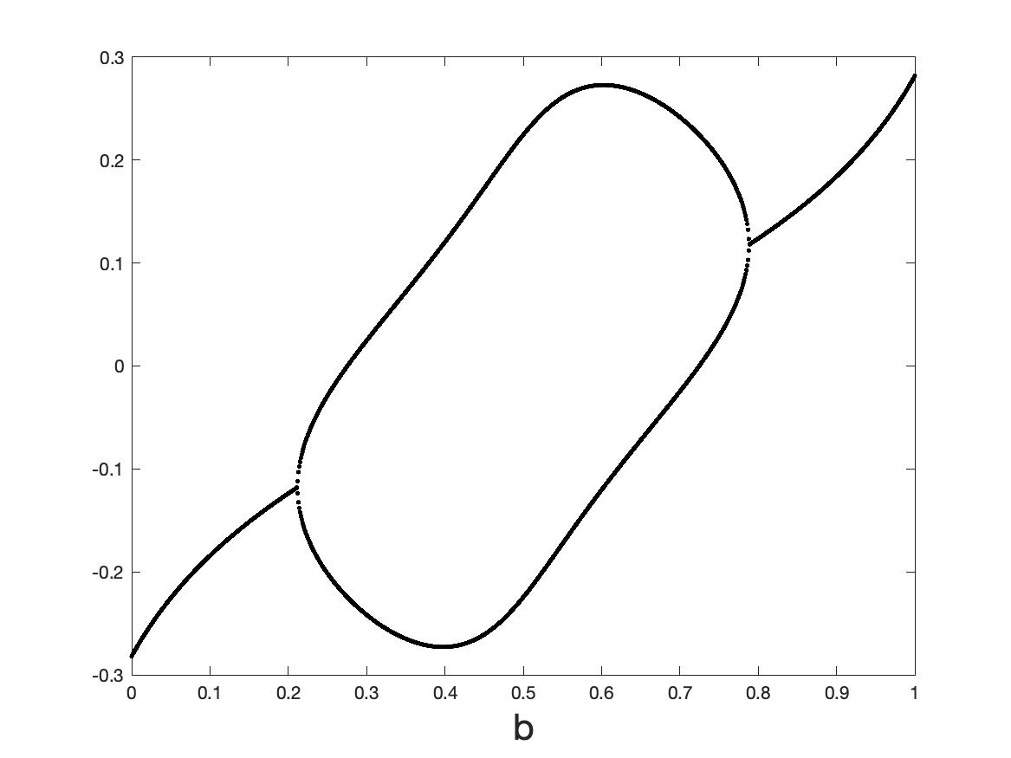
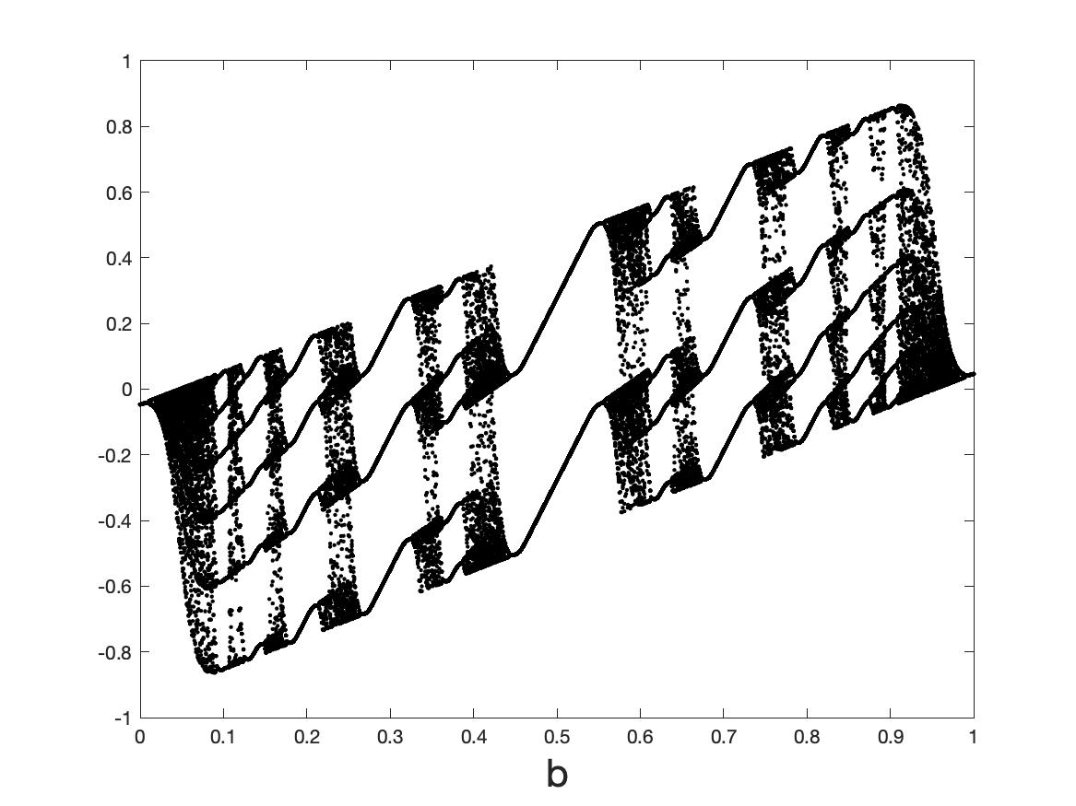
Omega-limit sets as a function of smoothing (when a = 0.8)
c = 1
c = 5
c = 10
c = 50
c = 1000
Border collision

Slide 13
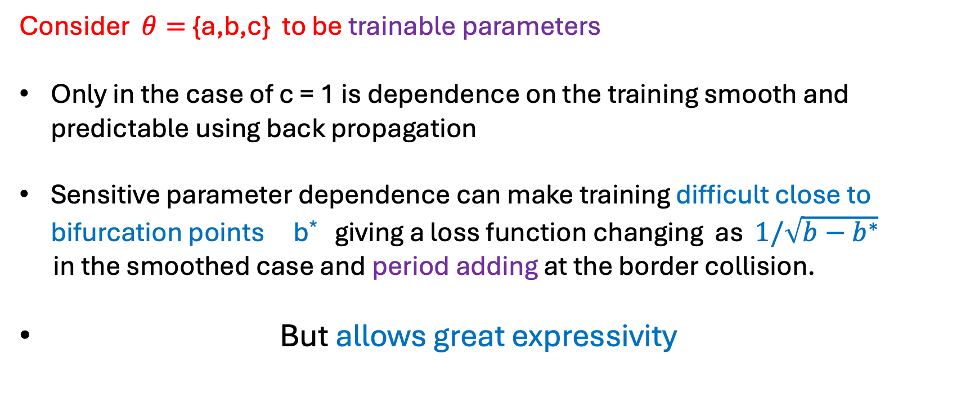
Conclusions from the results
High gradient of the tanh function leads to chaotic behaviour in certain cases. Hard to define a loss function and dependence of the loss function on the input/parameters in this case
Consider $θ=${a,b,c} to be trainable parameters
Only in the case of c = 1 is dependence on the training smooth and predictable using back propagation
Sensitive parameter dependence can make training difficult close to bifurcation points b* giving a loss function changing as $1/\sqrt{b−b^{∗}}$
in the smoothed case and period adding at the border collision.
But allows great expressivity

Slide 14

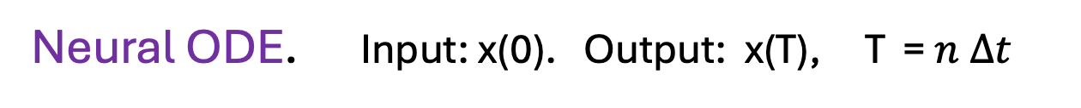
Neural ODES [Chen et. al] : The ResNET architecture as a flow
Let t = $n Δt$
Let $∆t →0$
Neural ODE. Input: x(0). Output: x(T), T = $n Δt$

Slide 15
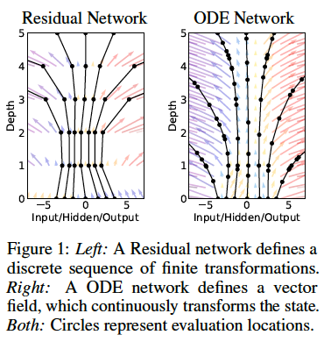
Idea [Chen et. al.]:
Replace the NN by solving the Neural ODE using an ODE
solver eg. RK4, Adam
Training now becomes a question of finding the functions
A(t), b(t), c(t)
Advantages in memory efficiency and back propagation
This a problem in optimal control theory

Slide 16
Training such a ‘Neural ODE’. [Chen et. al 19], [Pontryagin 62]
Consider the parametrized Neural ODE
Compute solution using an ODE solver
Loss function L( . )

Slide 17
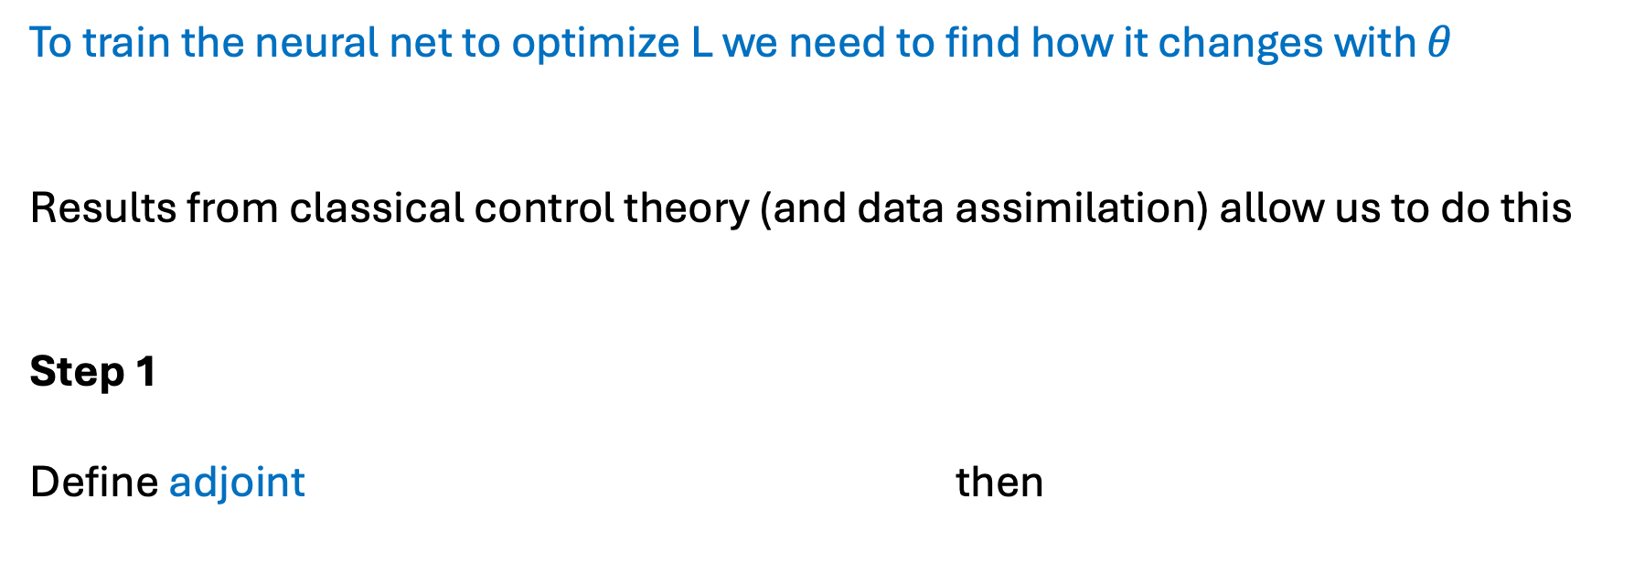
To train the neural net to optimize L we need to find how it changes with $θ$
Results from classical control theory (and data assimilation) allow us to do this
Step 1
Define adjoint then
Compute a(t) using an ODE solver ‘backwards’ starting from z(T)

Slide 18

Step 2
Compute the gradient of L by solving a third ODE
Can then train $θ$ to optimize L using gradient descent
[Chen et. al.] implement this using an adaptive Adam solver.

Slide 19
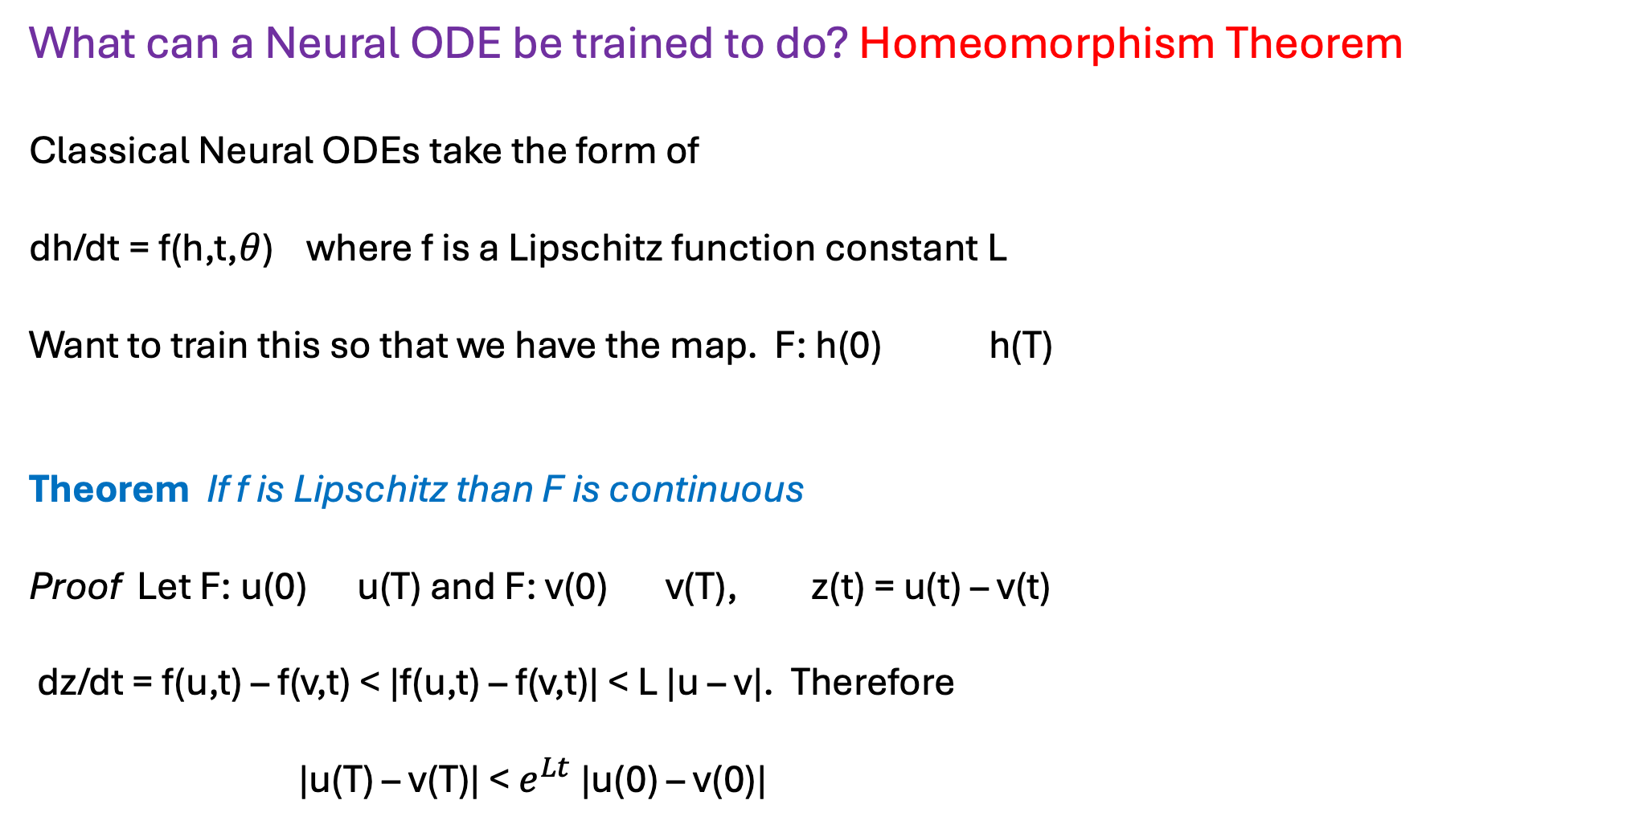
What can a Neural ODE be trained to do? Homeomorphism Theorem
Classical Neural ODEs take the form of
dh/dt = f(h,t,$θ$) where f is a Lipschitz function constant L
Want to train this so that we have the map. F: h(0) h(T)
Theorem If f is Lipschitz than F is continuous
Proof Let F: u(0) u(T) and F: v(0) v(T), z(t) = u(t) – v(t)
dz/dt = f(u,t) – f(v,t) < |f(u,t) – f(v,t)| < L |u – v|. Therefore
|u(T) – v(T)| < $e^{Lt}$ |u(0) – v(0)|

Slide 20
Conclusion:
Topology of the input data is the topology of the output data

Slide 21


Example: Want to train a Neural ODE to separate data
eg. dogs and cats. [+Davide Murari]
Can resolve this topology with a Neural ODE

Slide 22
But this data topology cannot be resolved into two points using a smooth Neural ODE
Have to either use a MAP or a non-Lipshitz Neural ODE

Slide 23
This data topology CAN be resolved using a non-smooth Neural ODE

Slide 24
Discontinuous flow breaks the topology and allows data separation
Question: How do we train these systems?

Slide 25
Dynamical systems defined by Neural Nets and learning dynamics from data
Original DS:
Data points:
Train: a NN to approximate this dynamics via:
Also (and confusingly) called a Neural ODE eg. by Matlab

Slide 26
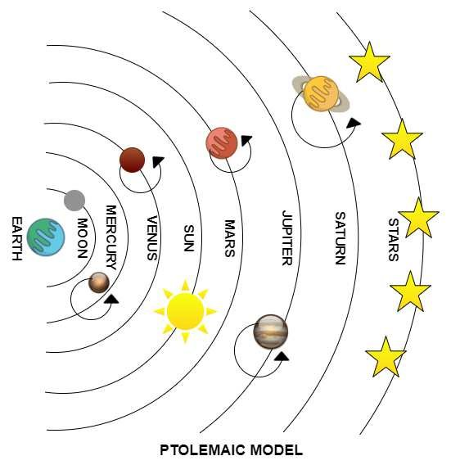
Big literature on these systems
Ptolemaic model of the solar system
Standard learning
Echo State Networks, Reservoir networks
Especially good for chaotic dynamics
SINDy approach (Kutze) using a very careful choice of RHS (can even work from video data)

Slide 27
Training such a ‘Neural ODE’. I [From MatLab website]
Example:
Neural ODE:
Solve: using RK45

Slide 28
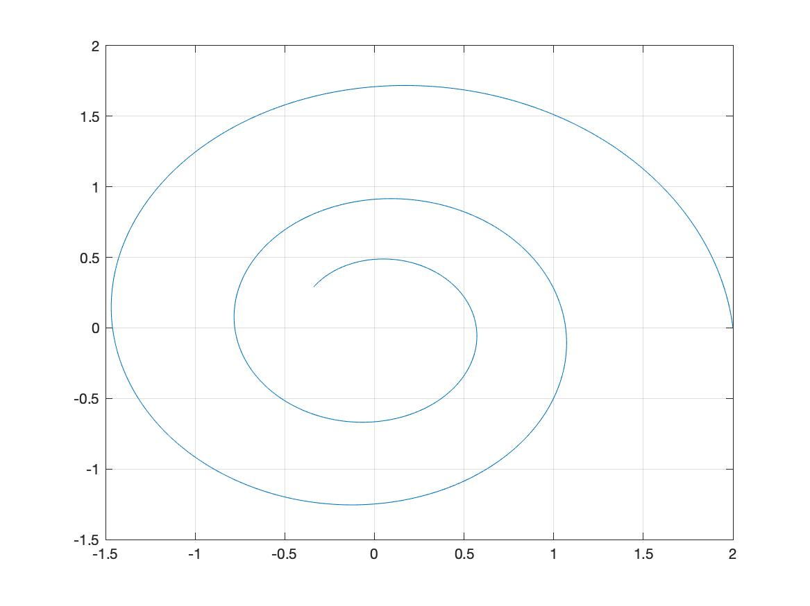
Training trajectory starting from: x(0) = [2,0], t = [0,15], 2000 points

Slide 29
Define loss: $L(θ)$
Implement NN using 2 layers and tanh activation
Compute gradients directly from the ODE solver using the adjoint method as before
Optimize using ADAM using first 400 training points

Slide 30
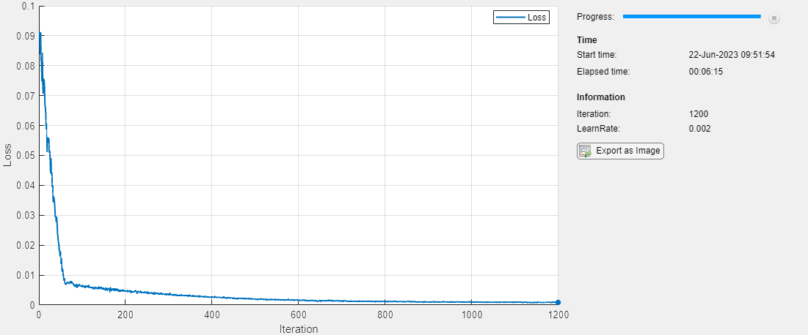

Slide 31
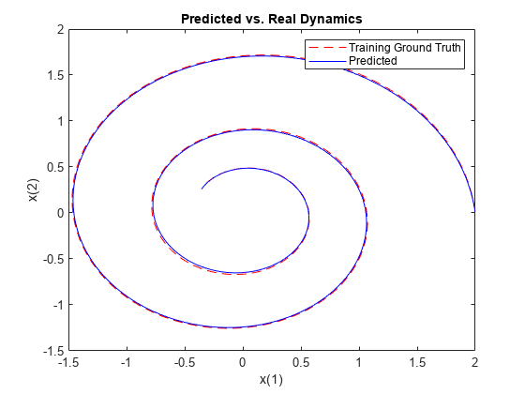

Slide 32
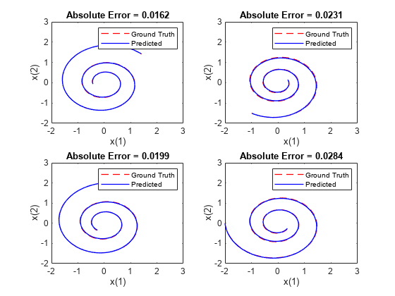
Prediction error is good for initial data close to the training trajectory

Slide 33
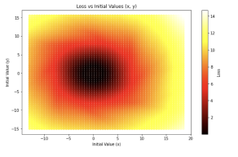
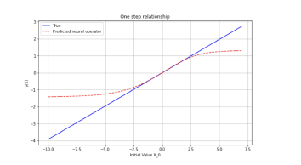
Loss increases as we move away from the training trajectory [+Libo Chen]

Slide 34
By way of contrast:
Assume that
Find matrix B
100 points:
400 points:
2000 points:

Slide 35
SINDy [ Brunton et. al. ]
ODE:
Data:
Plus noise
Assume: f(x) can be constructed from a library of known functions

Slide 36
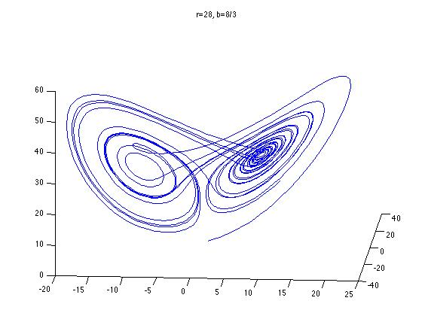
Eg. Lorenz Equations:

Slide 37
Library:
Coefficients:
Seek a SPARSE approximation of the form:

Slide 38
SiNDY

Slide 39
Possible dynamics of Neural ODEs
f(.) output of a feed-forward Neural Network
f(.) Can be piecewise smooth, continuous or even discontinuous
Non-smooth nature of the dynamics places a significant constraint on the possible dynamics of the neural ODE, and helps understand what dynamics might be possible

Slide 40
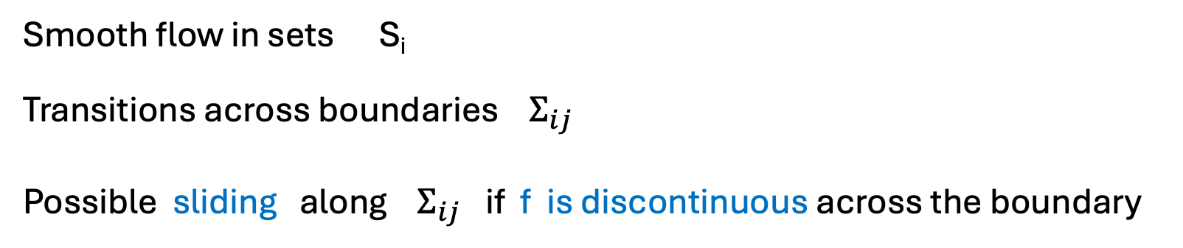
For example, NN naturally lead to:
Filippov Flows
Smooth flow in sets S_{i}
Transitions across boundaries $Σ_{ij}$
Possible sliding along $Σ_{ij}$ if f is discontinuous across the boundary

Slide 41
Filippov dynamical system without sliding
Typical ‘transverse’ intersection

Slide 42
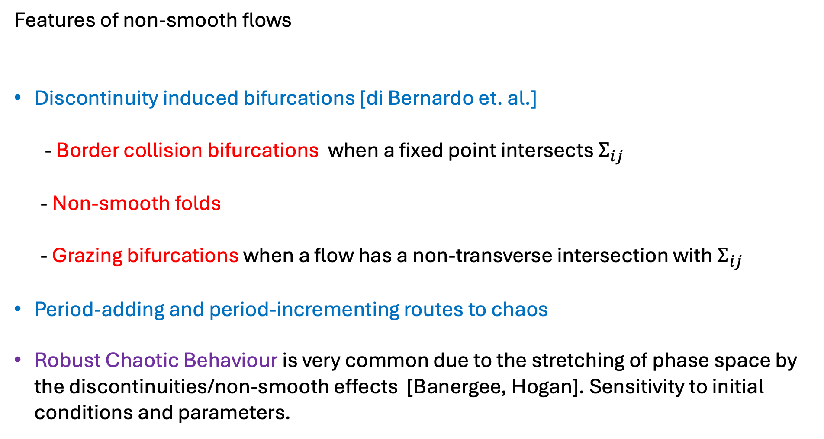
Features of non-smooth flows
Discontinuity induced bifurcations [di Bernardo et. al.]
- Border collision bifurcations when a fixed point intersects $Σ_{ij}$
- Non-smooth folds
- Grazing bifurcations when a flow has a non-transverse intersection with $Σ_{ij}$
Period-adding and period-incrementing routes to chaos
Robust Chaotic Behaviour is very common due to the stretching of phase space by the discontinuities/non-smooth effects [Banergee, Hogan]. Sensitivity to initial conditions and parameters.

Slide 43
Example 1: Border equilibrium bifurcation in a climate related NODE with a (smoothed) Heaviside activation function
Smoothed

Slide 44
Unforced system (Heaviside)
Two Fixed points
Physical
Virtual

Slide 45
Theorem
There exist critical values of the parameter d
If fixed point is physical and globally attracting
If fixed point is physical and globally attracting
If see a periodic solution
Transitions occur at Border Collision Bifurcations when

Slide 46
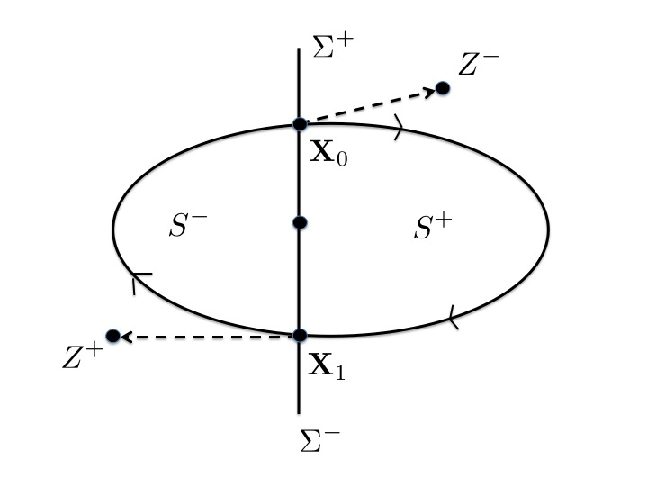
Existence of a periodic orbit
Virtual
F(X) > 0
F(X) < 0
Virtual
: F(X) = 0
Proof using the Brouwer Fixed Point. theorem

Slide 47
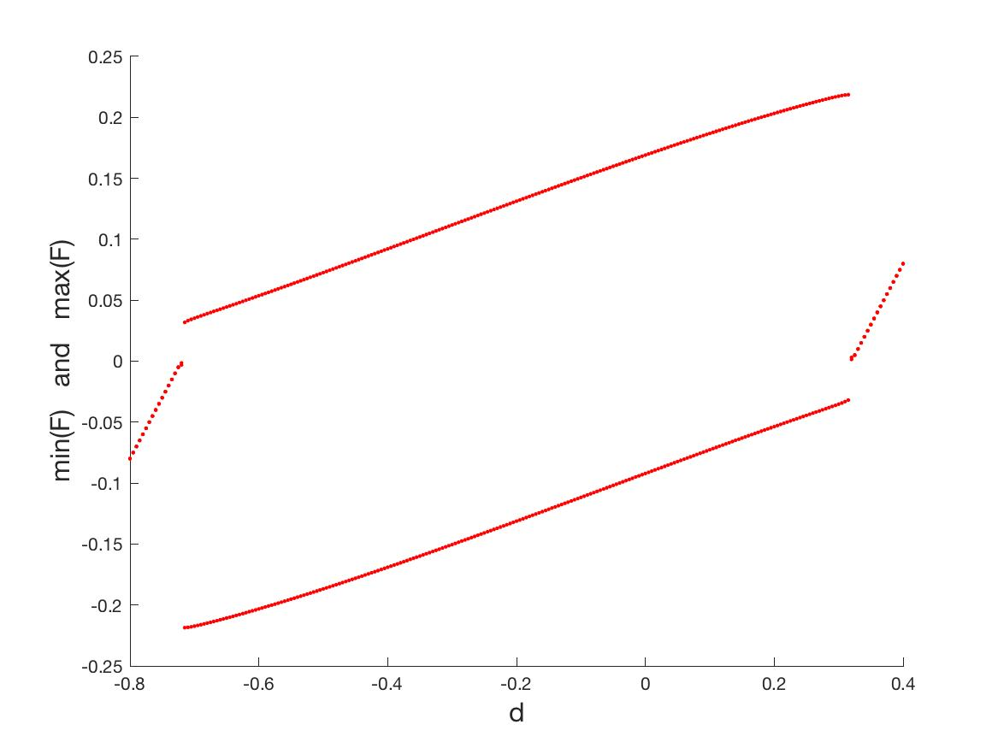
Bifurcation diagram: Heavyside
Periodic
Fixed point
Border collision bifurcation
Fixed point
$$η=10000$$

Slide 48
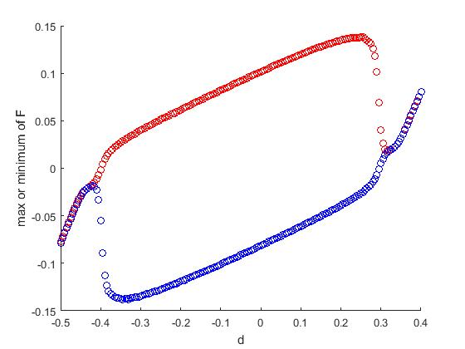
Bifurcation diagram: (smoothed) tanh
Periodic
Fixed point
Sub-critical Hopf bifurcation
Fixed point
$$η=100$$

Slide 49
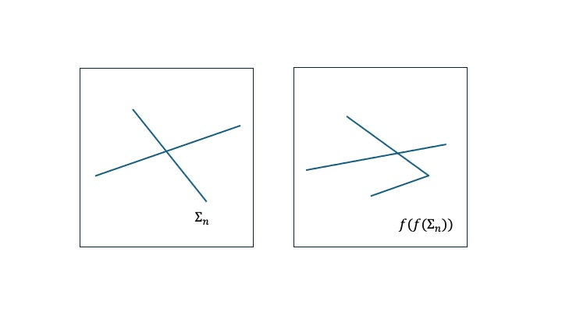
Example 2: Fixed point, Limit Cycle, and Chaotic Dynamics in ReLU type ODEs
(+,+)
(+,0)
(0,+)
(0,0)

Slide 50
Evolution of a fixed point. (2-dimensions)
Back propagation OK
FP
Back propagation fails

Slide 51
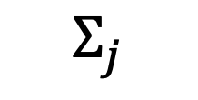
Local behaviour (n – dimensions) when back propagation fails
c^{T} x = d
$$Σ_{j}$$

Slide 52
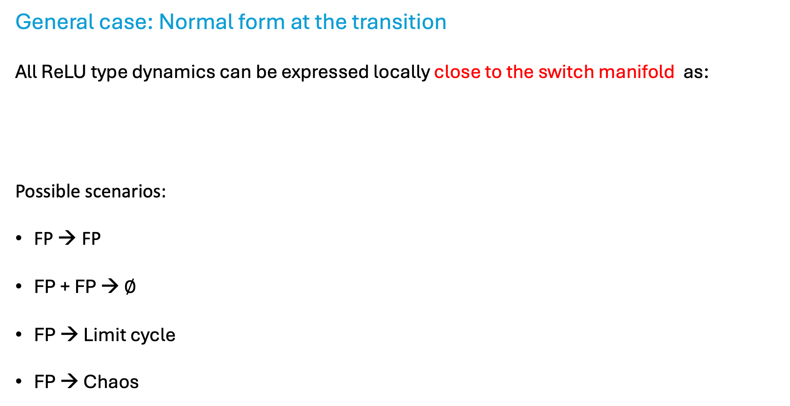
General case: Normal form at the transition
All ReLU type dynamics can be expressed locally close to the switch manifold as:
Possible scenarios:
FP → FP
FP + FP → $∅$
FP → Limit cycle
FP → Chaos
Can classify many of the transitions in terms of the structure of A_{i} and b.
[Freire], [Carmona]

Slide 53
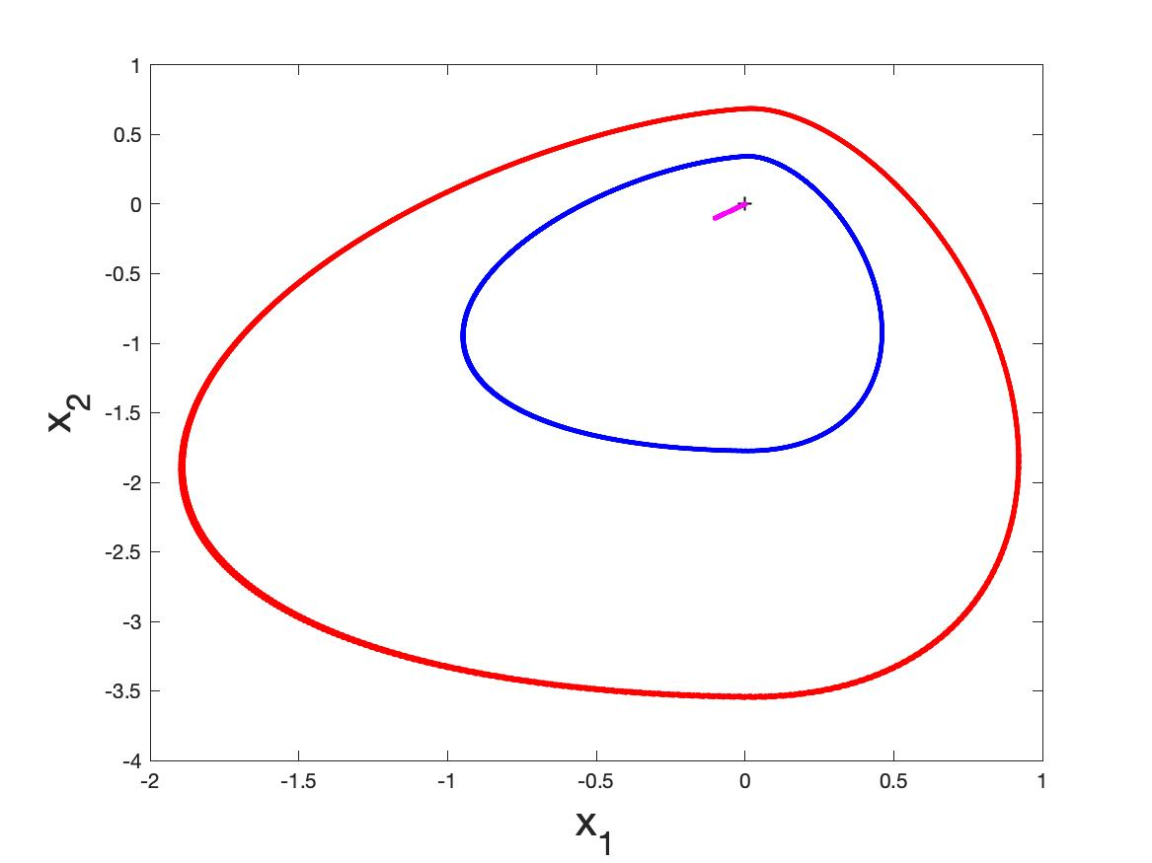
Example: FP → Limit Cycle

Slide 54
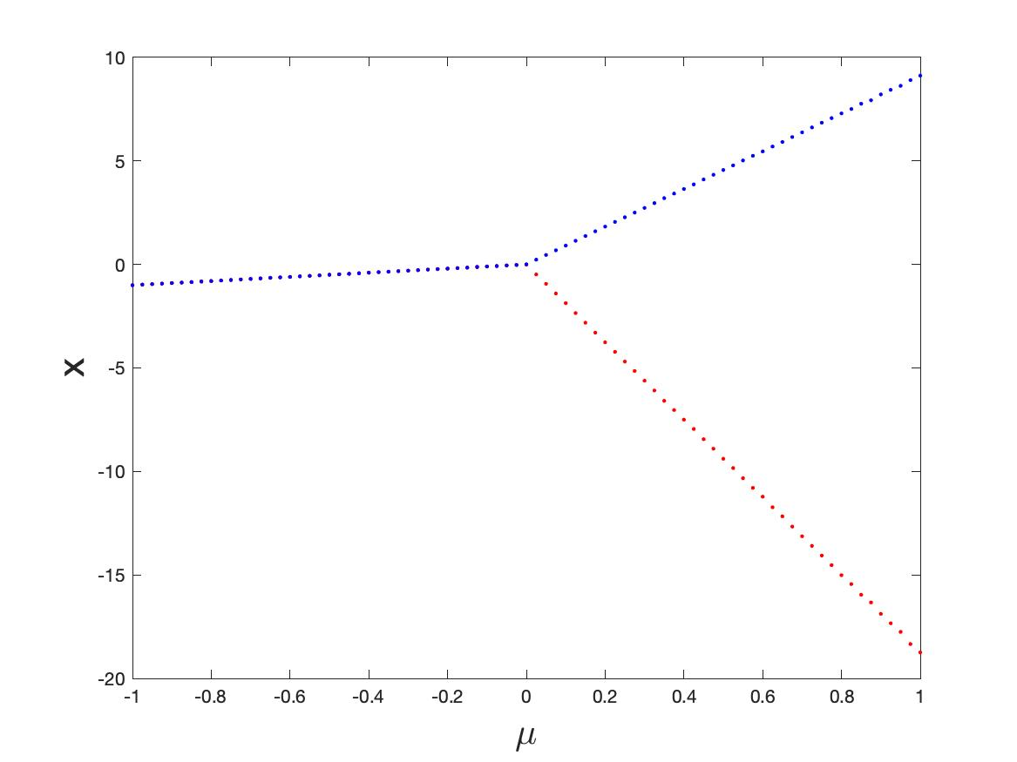
Max(x)
Fixed point
Min(x)
Limit cycle

Slide 55
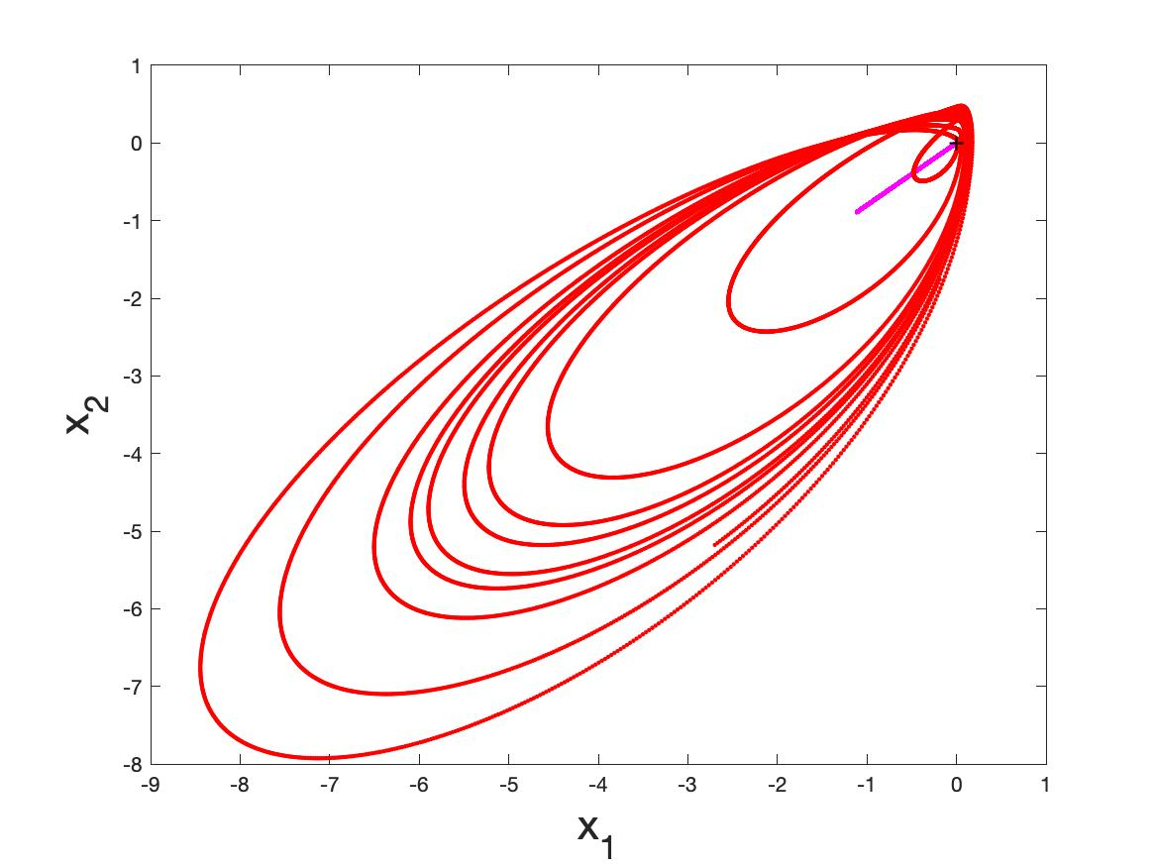
Example 2: FP → Chaos

Slide 56
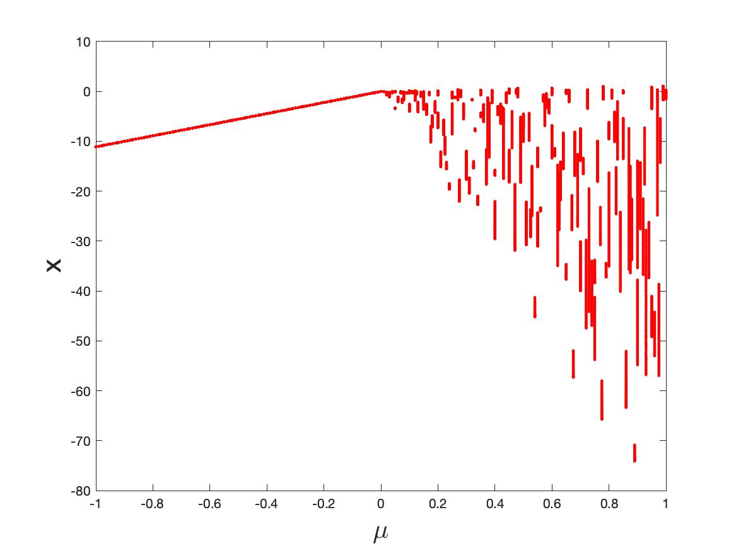
Fixed point
Chaos

Slide 57
Conclusions and Next Steps
Have demonstrated that typical activation functions can lead to complex (FP, Periodic, chaotic) in feed forward NN and neural ODEs
Can classify certain complex behaviour at transition points where back propagation breaks down
Need to test on realistic ML architectures with multiple switching surfaces
Need to understand how identifying NSD structures might improve training and control as discontinuity manifolds are crossed

Slide 58
References
H. Nusse, E. Ott, and J. Yorke. Border collision bifurcations: an explanation for observed bifurcation phenomena. Phys. Rev. E, 49:1073–1076, 1994.
Mario Di Bernardo, B. , et. al. ‘Piecewise smooth dynamical systems: theory and applications’, Springer 2008
Igor Belykh, Rachel Kuske, Maurizio Porfiri, and David J. W. Simpson, ‘Beyond the Bristol book: Advances and perspectives in non-smooth dynamics and Applications, 2023
E. Freire, E. Ponce, F. Rodrigo, and F. Torres. ‘Bifurcation sets of continuous piecewise linear systems with two zones’. International Journal of Bifurcation and Chaos, 8(11):2073–2097, 1998.
V. Carmona, E. Freire, E. Ponce, and F. Torres. Bifurcation of invariant cones in piecewise linear homogeneous systems. International Journal of Bifurcation And Chaos, 15(8):2469–2484, August 2005.
Andrea Ceni, Peter Ashwin, Lorenzo Livi, ‘Interpreting Recurrent Neural Networks Behaviour via Excitable Network Attractors’, Cognitive Computation (2020) 12:330–356

